Slide 1
Session 9. Vertical Integration, Outsourcing, Joint Ventures Wahaha-Danone
Competitive Strategy
Luis Garicano

Slide 2
Vertical Integration: The Question
Make or Buy?
Should Booth operate cafeteria or outsource?
Should Ford own Hertz?
Forward integration: a firm performs activities typically done by its customers (downstream firms)
Backward integration: a firm performs activities typically done by its suppliers (upstream firms)

Slide 3
Make-or-Buy Fallacies
Fallacy 1: Vertical integration is better because we can obtain the activity “at cost”, avoid supplier mark-up.
In perfectly competitive market, price equals long run average cost
Can only do better if own costs lower than markets
If market is not competitive, must understand why
Why can you (not others) overcome barriers to entry
Why is market not working efficiently?
=> Would your competitor want to buy from you?

Slide 4
Make-or-Buy Fallacies
Fallacy 2: Integration to obtain the other firm’s profit.
High attractiveness as a reason to enter is often problematic argument
Why is it attractive?
Why don’t more competitors enter then
Will it stay attractive
BUT… not impossible if there are barriers to entry that only few can scale

Slide 5
Rationales for (or against) vertical integration
Economics of scale and scope (mostly against V.I.)
Incentives: Trade-off between
Strong market incentives (but only for what market rewards!)
Weaker, but often more balanced incentives under integration
Hold-up and relation-specific investments (mostly in favor of V.I.)
Legal considerations & others
Tax avoidance: Using transfer prices to shift revenues (in favor)
Avoiding anti-trust regulations on RPM, exclusive distribition (in favor)
Labor laws/Unions: Sometimes easier to fire a supplier than employee; avoid high union wages (against)

Slide 6
Economics of Scale and Scope
Economies of Scale and Scope:
Supplier/buyer firms can achieve more economies of scale in production:
In-house department produces less than market specialist
Booth outsources cafeteria, cleaning services,…
Disney might outsource running hotels.
Do you have a competitive advantage in this part of the value chain? Would your competitor want to buy from you?

Slide 7
Incentives (I)
Divisions within firms do not face same incentives as market firms
Suppliers have strong incentives to improve efficiency
Can switch among suppliers; market will tend to drive out those that are inefficient or don’t innovate
Harder to motivate managers within divisions
Absence of market discipline: often guaranteed in-house orders
Head-quarters always loom large in key decision
Weaker accountability
Lengthy authorization stifles initiative and motivation

Slide 8
Incentives (II)
Trade-off:
Market: strong, but possibly unbalanced incentives.
Partner has incentives to do what the market rewards → also market suffers from YGWYPF
Internal production: Weak, but more balanced incentives.
Benefits of low powered incentives
Weakening market incentives may lead to a better allocation of effort toward things markets do not directly reward

Slide 9
Incentives (III)
What you should outsource depends on what markets can or cannot easily reward directly
How easy is it to write a formal contract specifying performance?
Difficult things tend to be user-specific, intangible, service-oriented, difficult to specify in advance, etc.
Difficult things often involve “coordination”, “cooperation”
Example: Bombardier and Morrison Knudsen in railcars

Slide 10
Incentives (IV)
Outsource only when “performance” can be easily specified and monitored
If activity hard to measure, performance rewards tricky
In the latter case, use the firm, use direct monitoring/hierarchy together with subjective rewards, long term and implicit contracts, etc.
thus firm associated with limited incentives, wage contracts etc.

Slide 11
Initiative vs. coordination
Use market: provide strong rewards on the margin to encourage initiative taking
but risk lack of cooperation
or use ‘firm’ /bureaucracy–not so strong rewards
obtain coordination but at the risk of not rewarding effort

Slide 12
Initiative vs Coordination
INITIATIVE
Markets
Firms
COOPERATION

Slide 13
Incentives: Examples
Sales : Three activities potentially important in sales
Making current sales (1)
Cultivating long-term customer satisfaction (2)
Gathering information about customer needs (3)
If only selling activities are important: independent sales agent
high power incentives – pay a commission per sale
allow non exclusivity (no problem, motivated by commission)
If non-selling activities (2), (3) important – employee agents
pay all in wage, low-powered incentives
not allow to sell other goods

Slide 14
Incentives: Examples (III)
Need for rapid / flexible coordination
If input needs are complex & changing, constant negotiation / haggling can be very costly
Difficult to provide incentives up front for suppliers to respond in an efficient way
Example: ZARA’s quick response business model
Can contracts solve coordination problems? Often they can:
→ Airline Alliances

Slide 15
Recall: Hold-up and relation-specific investments
Hold-up is an important reason for vertical integration
Key issue in Business-to-Business, but also important within organizations.
When two companies start working with each other, there is often a “fundamental transformation” from a competitive relationship to a specific relationship. The parties become dependent on each other.
Basic idea of hold-up
I ask to renegotiate an earlier (implicit or explicit) agreement in order to increase my share of the pie.
If the contract is not water-tight, you often have not much choice but accepting new terms.

Slide 16
Recall: Hold-up
Conditions that make hold-up likely/important
Asset Specificity – Relationship-specific investments
A specialized asset is tailor-made for one or a few specific buyers
Opportunities for exploitation are greater when one firm is wholly dependent on another
Specific physical capital, specific human capital, site-specific capital
Uncertainty and contracting difficulties
Infrequent relation

Slide 17
Hold-up (II)
Classic Hold-up Example: GM and Fischer-Body
In stable environment, “easy” to write contract about quantity, price and quality of car bodies Fischer should supply to GM
E.g. 2000 bodies a day, of a specified type, for the foreseeable future
But what if changes in the environment?
Shock to demand for GM, shock to cost to Fischer-Body, new regulations on car pollution, new trade agreement with Japan, innovation in car and body production, etc…

Slide 18
Hold-up: Contracts vs Integration
In theory, hold-up could avoided through optimal arm length’s contracts
Optimal contracts do not need to be renegotiated
However, writing such optimal contracts is costly
Difficult to think ahead, describe all possible contingencies and actions to be taken in each case
Inability to specify all outcomes, verify actions create potential for opportunistic behavior when contracts have to be revised
Each side may try to interpret the terms of a contract to its advantage, especially when terms are vague or even missing

Slide 19
Hold-up: Contracts vs Integration
The hold-up problem raises transaction costs
More difficult contract negotiations and renegotiations, distrust:
costs associated with trying to write better contracts, costs of disputing contracts, renegotiating.
Reduced investment in relationship-specific investments
Refusal to make “tailored ” or “customized” investments for a buyer
Vertical integration reduces these transaction costs
Integration gives one agent control over assets on both sides and eliminates the hold-up problem

Slide 20
Hold-up: Examples
Other Examples
Make-or-buy in the aerospace industry, car industry
High design specificity inputs more likely to be produced in-house
Backward integration in can making by Beer and Food Producers
Coal Mines and power plants

Slide 21
Empirical evidence
Strong evidence that vertical integration is more likely when potential hold-up problems are big
e.g. Quasi-integration by automobile manufacturers more likely when specialized machines cannot be used to produce for other manufacturers
“Design-specificity” in airline components predicts vertical integration
Evidence that inputs which are “complex” or require intensive coordination more likely to be produced in-house

Slide 22
Make or cooperate
Long-run relationship with exclusive (or small number of) suppliers may be a substitute for In-House production
Exclusivity provides incentives to supplier to make relationship-specific investments.
Less risk of hold-up by buyer which is now more dependent on supplier.
Increases the frequency of the interaction
Repeated interaction mitigates risks of hold-up by supplier or buyer.

Slide 23
Make or cooperate: Alternatives to Vertical Integration
A variety of in between situations can try to capture the best of both worlds
Tapered integration
Joint ventures and strategic alliances
Subcontractors networks & Japanese Keiretsu
The crucial element in JVs, alliances, Keiretsusis the relational contract aspect
We cooperate because we expect the other side to cooperate
The existence of a future is thus key
And the partners have to shape situation on the ground to attain their objectives
Role of the law is limited, particularly in developing world
Is all about TRUST, and not about what is written in the contract!

Slide 24
1. Tapered integration
Mixture of vertical integration and market exchange = make AND buy
A firm may produce part of its input on its own and purchase the rest
A firm may sell part of its output through in-house sales efforts and sell the rest through independent distributors

Slide 25
Examples of tapered integration
Hotel, video, hamburger chains
own some of their retail outlets
award franchises for others
Coca-Cola and Pepsi
have their own bottling subsidiaries
also rely on independently owned bottlers to produce and distribute for some markets
General Motors
has its own market research division
also purchases market research from independent firms

Slide 26
Tapered integration: advantages
Additional input/output channels without massive capital investments (helpful for growing firms)
Information about costs and profitability from internal operations can help in negotiating with market firms
threat of self manufacture can discipline external channels, threat to use the market further motivate the performance of its internal channels
Internal supply capabilities will protect against potential holdups

Slide 27
Tapered integration: disadvantages
Possible loss of economies of scale
Coordination may become more difficult since two production units must agree on product specifications and delivery times
A firm’s monitoring problems may be exacerbated
duplicate efforts of contracting & monitoring
mistakenly establish the performance of an inefficient internal supplier as the standard to be met by external suppliers
Managers may maintain inefficient internal capacity rather than close facilities that had formerly been critical to the firm

Slide 28
2. Strategic alliances and joint ventures
Alliances involve cooperation, coordination and information sharing for a joint project while the participating firms continue to be independent
Autonomy
A joint venture is an alliance where a new independent organization is created and jointly owned by the promoting firms
Staffed and operated by employees of one or more parent firms or staffed independently

Slide 29
Strategic alliance
Horizontal (same industry), vertical (supplier-buyer) or other
Alliances and joint ventures are intermediate solutions, between market exchange and vertical integration
More cooperation, coordination and information sharing than would occur in an arm’s length market transaction
More later on that
Rather than rely on contracts, an alliance relies on trust and reciprocity (marriage)
Disputes must be resolved through negotiation

Slide 30
Strategic alliance - scenarios
Uncertainty of future activities prevents the parties from going into the specifics of decisions in contract
Transactions are complex and one cannot count on contract law to “fill the gaps”
Existence of relationship-specific assets and potential holdup problem
Excessively costly for one party to develop the necessary expertise or to carry all of the activities itself
Market opportunity that induced the transaction is not expected to last very long making a long term contract or merger unattractive
Regulatory environment necessitates acquiring a local partner for the venture

Slide 31
Strategic Alliance Toys “R” Us McDonald’s Japan
Start in 1990
To ease the entry of Toys “R” Us in Japan
Special law on large retail store: need to be approved before building the stores
Law protects small merchants
Toys “R” Us need a local partner
Choice of McDonald Japan

Slide 32
Strategic Alliance Toys “R” Us McDonald’s Japan
Why McDonald’s Japan?
President influential politically
Good knowledge of Japanese real estate
Experience of building McDonald’s Japan
Deal
20 % stake of McDo Japan in Toys “R” Us Japan
11 stores: 9 would have a McDo inside
Big advantage: obtain political know-how, site selection expertise and business connections
Costly or even impossible if alone

Slide 33
Strategic Alliance Toys “R” Us McDonald’s Japan
Why not sign a contract?
Difficulty to measure outcome (efficiency of government lobbying)
Poor knowledge of the Japanese situation
Could not monitor that McDonald did his job properly
Fewer incentives problems with the alliances because of the stake in the project
IT is about the relational contract!
Parties cooperate because they care about future gains
Less hold up fear for that reason as well

Slide 34
Strategic alliances: drawbacks
Leakage of private info
Similar as traditional market transactions
Risk of losing control over information when collaborating, even worse
Compromised coordination and time issues
No formal mechanism for making decisions or solving disputes
Free rider problem (monitoring) + influence costs (costs of influence activities for the allocation of resources)

Slide 35
3. Collaborative relationships
Japanese industrial firms appear to be less vertically integrated compared to their western counterparts
Smaller and more specialized in their particular place in the vertical chain
Japanese firms organize the vertical chain using long term collaborative relationship among firms rather than arm’s length transactions
Two major types of collaborative relationships are found in Japan
Subcontractor networks and Keiretsu

Slide 36
Subcontractor Networks
Japanese manufacturers maintain close, informal, long term relationship with their network of subcontractors
The typical relationship between a manufacturer and a subcontractor involves far more asset specificity in Japan than in the West
higher degree of collaboration
delegation of more responsibilities to subcontractor

Slide 37
Japanese firms
A typical Japanese firm has about 70 per cent of its shares held by other companies
The shares are held by a large number of firms in relatively small fractional parcels
The firm has some kind of transactional relationship with these corporate shareholders (banking, insurance, lending, supply of inputs, purchase of outputs)
The firm holds shares in many of the these firms: the shareholdings are reciprocal
Firms hold each other’s shares as “stable shareholders” (antei kabunushi)

Slide 38
Keiretsu
Like a subcontractor network but involves more formalized institutional linkages
Member firms of a keiretsu hold each other’s equity
Links among firms are further strengthened by personal relationships among top executives
Most of the key activities in the vertical chain are performed by members of the keiretsu
6 largest keiretsu – Mitsubishi, Sumitomo, DKB, Mitsui, Fuso and Sanwa
Mitsubishi & Mitsui
Core banks place nearly 200 representatives on the board of other keiretsu members, choose CEOs of about 20% of the member firms

Slide 39
Types of keiretsu
Horizontal keiretsu (kinyûkeiretsu)
Affiliated `brother and sister` companies spanning different industries
Vertical keiretsu
Manufacturing keiretsu (sangyô) Assembled parts move up to the parent through a pyramid of supply companies | Distribution keiretsu (ryûtsû) The parent sends finished goods down through a pyramid of distributors to retailers

Slide 40
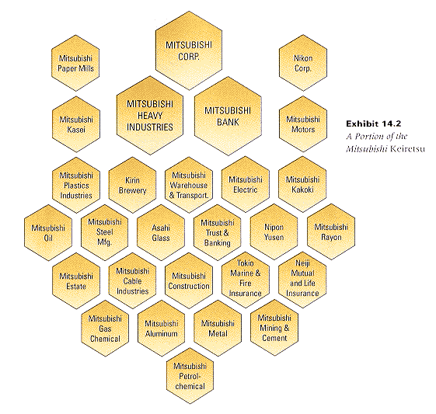
Mitsubishi Keiretsu

Slide 41
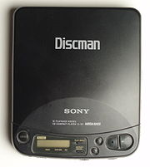


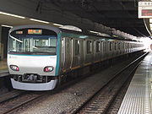


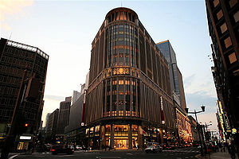
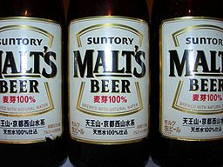
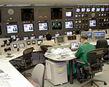
Mitsui keiretsu

Slide 42
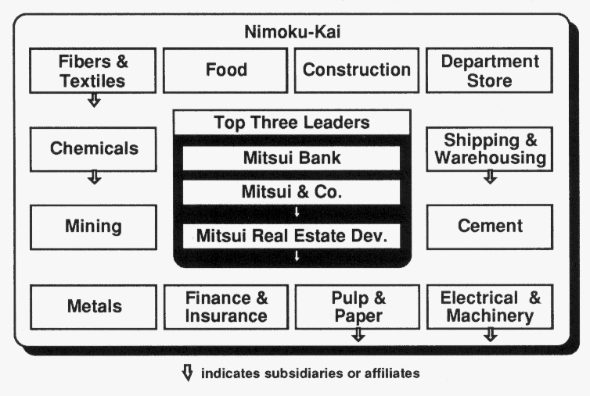
Mitsui keiretsu

Slide 43
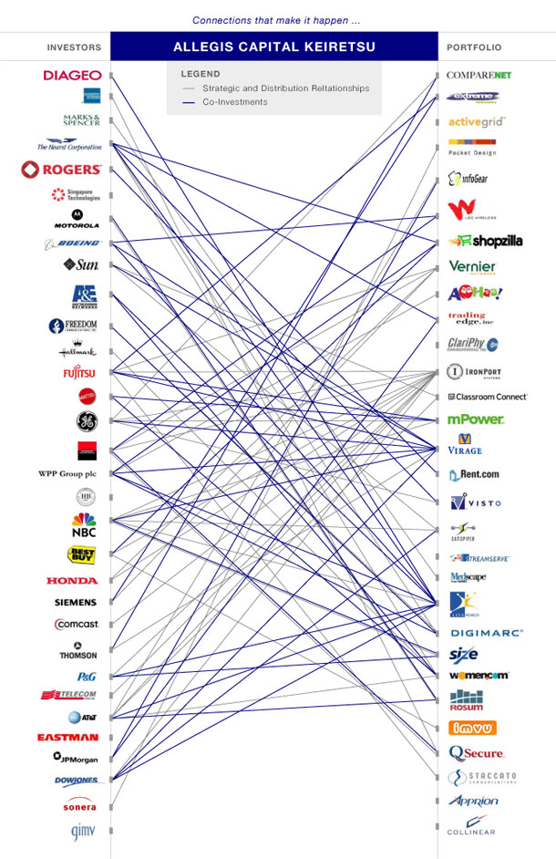
American keiretsu

Slide 44
Keiretsu: content of the relational contract
Where a keiretsu member involved in production experiences a sharp upsurge in demand, it is understood that suppliers in the keiretsu will increase their production without raising supply prices.
If one keiretsu member requires a product change, it is understood that suppliers will participate in the design discussions
In a keiretsu, each worker learns each of the others´ businesses, inventory needs, marketing practices, …
Easy coordination, no short term gains from one member w.r.t. others, lower chance of holdups

Slide 45
Vertical Integration: Summary
Default: Use Market (BUY)
Take advantage of high-powered market incentives!
Would your competitor want to buy from you?
Do you have any competitive advantage in this business?
Integrate (MAKE) if:
If difficult to write good “performance” contracts
YGWYPF: Market provides strong incentives but only for what the market rewards
Can you contract on coordination, cooperation?
If potential hold-up results in large transactions costs
Asset specificity
Uncertainty/Complexity => contracting difficult

